Slide 1
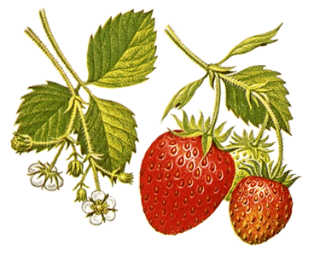
Strawberries
Nutrition
Eight strawberries contain 140% of your daily Vitamin C.
Strawberries are fat-free and low in calories: one cup of unsweetened strawberries has only 55 calories.
In addition, strawberries are good sources of folic acid, potassium and fiber.
The American Cancer Institute suggests that strawberries can play a part in helping you to reduce the risk of cancer or heart disease.
Fresh juice from sieved strawberry pulp has a cooling effect on feverish patients. Strawberry juice combined with honey will reduce inflammation or sunburn.

Slide 2
Strawberries
Botany
The strawberry belongs to the genus Fragraria, in the rose family, along with apples and plums. The name of the scientific classification was derived from the Old Latin word for fragrant. The modern Italian word for strawberry is still "Fragola.”
The Rose Family (By: Robert Frost)
The rose is a rose, And was always a rose. But the theory now goes That the apple's a rose, And the pear is, and so's The plum, I suppose. The dear only knows What will next prove a rose. You, of course, are a rose - But were always a rose.

Slide 3
Strawberries
Botany
The strawberry is not classified by botanists as a true berry. True berries, such as blueberries and cranberries have seeds inside.
The strawberry, however has its dry, yellow "seeds" on the outside (each of which is actually considered a separate fruit).
On the average, there are 200 tiny seeds in every strawberry.

Slide 4
Strawberries
History
Native American Indians called strawberries "heart-seed berries" and pounded them into their traditional corn-meal bread. Discovering the great taste of the Native Americans bread, colonists decided to create their own version, which became an American favorite that we all know and love... Strawberry Shortcake.
The English and French also found strawberries used the beautiful heart-shaped berries to landscape their gardens. In fourteenth-century France, Charles V ordered twelve hundred strawberry plants to be grown in the Royal Gardens of the Louvre.
To symbolize perfection and righteousness, medieval stone masons carved strawberry designs on altars and around the tops of pillars in churches and cathedrals.
In parts of Bavaria, country folk still practice the annual rite each spring of tying small baskets of wild strawberries to the horns of their cattle as an offering to elves. They believe that the elves, are passionately fond of strawberries, will help to produce healthy calves and an abundance of milk in return.
Madame Tallien, a prominent figure at the court of the Emperor Napoleon, was famous for bathing in the juice of fresh strawberries. She used 22 pounds per basin. Needless to say, she did not bathe daily.

